Slide 1
Discrimination Training and Reweighting of Interaural Level vs. Time Difference Cues
Udbhav Singhal1 , Maike Klingel 1,2 , Norbert Kopčo1
1 Institute of Computer Science, P. J. Šafárik University , 2 University of Vienna
This project is a continuation of the work supported by WTZ grant ASH (Adaptability in Spatial Hearing), #MULT 07/2020, APVV DS-FR-19-0025 and VEGA 1/0350/22, 2022-24.

Slide 2
Background
Normal-hearing (NH) listerners rely on two bineaural cues for sound locatization in horizontal plane:
- Interaural Time diference (ITD) results from difference in the travel time from a sound source to the ears to and farther from the source. They are dominant at low frequency (upto 1.5 kHz).
- Interaural Level Difference (ILD) where the sound is coming from the right side of your body is more intense at your right ear then at your left ear. They are dominant for higher frequency.

Slide 3
Backgraound
NH listeners weight binaural localizatio cues based on the sound’s frequency (Macpherson & Middlebrooks, 2002)
Many other factors which influencing binaural- cue weighting:
- Overall Level (Deatherage & Hirsh, 1959)
- Active manipulation of one of the cues (Lang &Buchner, 2008)
- Room Acoustics (Rakerd &Hartmann, 2010)
Studies attempting to induce a change in binaural cue weighting produced mixed results:
- No reweighting effect (Jeffress & McFaddeen, 1971)
- ILD weights increased, but ITD weights did not (Kumpik et al, 2019)
- Reweighting induced in both directions (Klingle, Kopco & Laback)
Notes:
However studies attempting to induce a change in binaural cues
For example – Jeffress & McFaddeen for example
Didn’t find any reweighting effect
Kumpik et all did observe increase in ILD, in terms of randomized during training but they didn’t observe change in ITD. Also they find increase in ILD reweighting if none of the cue randomized. It’s hard to tell whether they the thing

Slide 4
Aim
This study propose simpler reweighting the cues using left/right discrimination task which further don’t require sophisticated equipment (VR headset).

Slide 5
Methods
Three groups:
Training group (n = 10): Feedback congruent with ILDs (Data as collected during Maike study)
Training group (n = 14): Feedback congruent with ITDs
No-training control group (n = 11) (Data as collected during Maike study)
Auditory stimuli:
Narrow-band noise bursts (2-4 kHz)
Independent combinations of ITDs and ILDs
Testing on 3 consecutive days:
Day1: Pretest (both groups) + 1st training session (training group only)
Day 2: 2nd training session (training group only)
Day 3: 3rd training session (training group only) + Posttest (both groups)
Two-interval, 2AFC left/right discrimination task
Pre-/Posttest: Constant Stimuli
Training: 2 down 1 up adaptive staircase procedure
Notes:
Training group for ILD, ITD (to increase the ILD and ITD respectively)
Auditory stimuli (Narrow band burst in mid-frequency region)
To make sure none of the cues is weighted particularly strongly we, use independent combinations of ITDs and ILDs.
Two interval, Alternate Force Choice
To make sure all participant listen to same stimuli
So that we could train the participant individual threshold of their performance

Slide 6
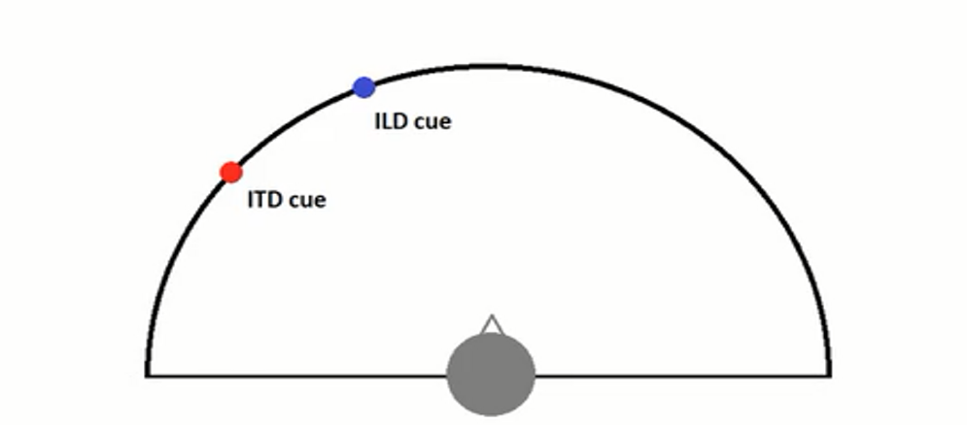
Methods – Pre-/Posttest

Slide 7
Methods – Pre-/Posttest
1st stimulus
Notes:
In this methods, we use 2 azimuth (ITD azimuth) corresponds to one azimuth and ILD azimuth corresponding to different azimuth. For participant it looks like the sound is coming in between these two, depending on the Binaural cue weight.
If I perceive ITD strongly than the sound to ITD azimuth and vice versa in case of ILD azimuth. We use various combinations of azimuth and cue disparity (which is distance between two)

Slide 8
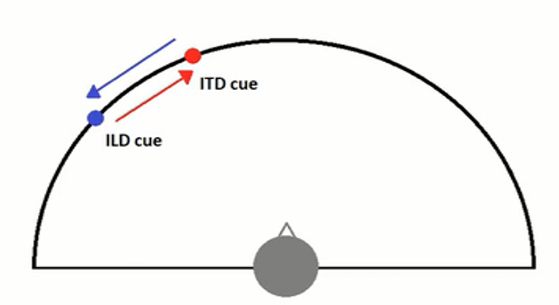
Methods – Pre-/Posttest
2nd stimulus
Notes:
In 2nd Stimulus we switch those, now they correspond to each other. The main idea here is if we switch the two azimuths, the cues are shifted in opposite directions with the same amount. If we weight equally then in the middle it doesn’t make any differences. The perception is more in that direction which is more strongly or dominated.

Slide 9
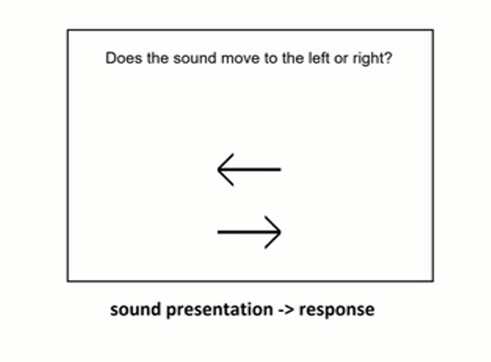
Task – Pre- /Posttest
Notes:
In pre/post we present two stimulus consecutively then ask whether they perceive the sound in left of right direction and respond accordingly to arrow key

Slide 10
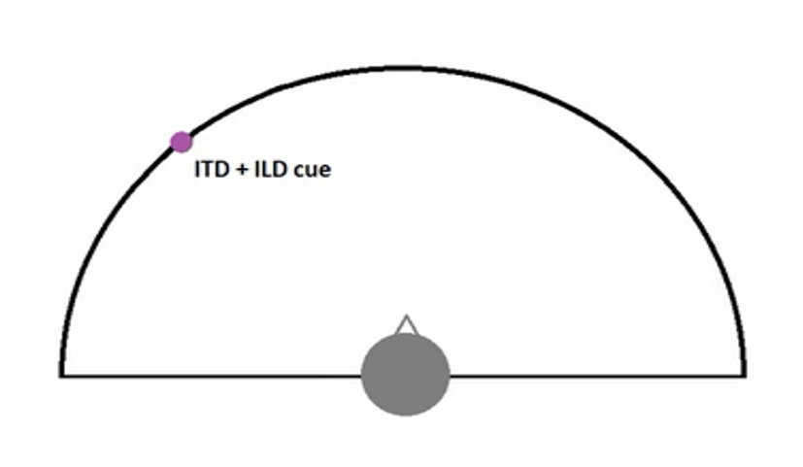
Methods - Training
1st stimulus
Notes:
We use slightly different method here, ILD and ITD corresponding to the same azimuth

Slide 11
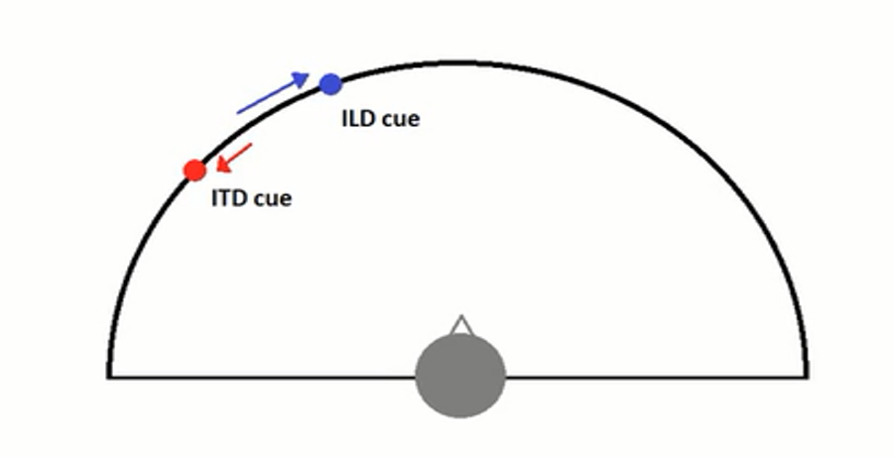
Methods - Training
2nd stimulus
Notes:
In 2nd stimulus, ILD shifted to right and ILD shifted to left.

Slide 12
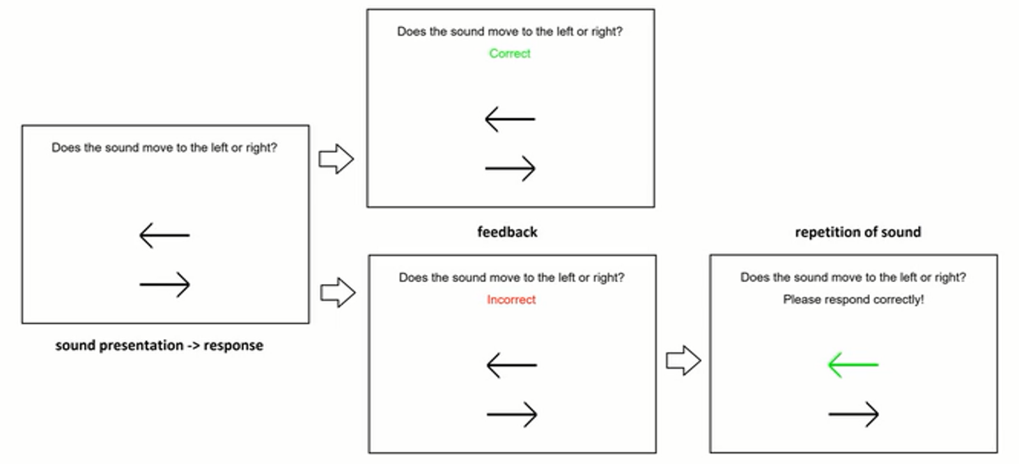
Task - Training
Figure: Experimental procedure. During the assessment, only the first screen was shown and no feedback was given. During pre-training and training, feedback was given after each response and if response was “in-correct” the stimulus pair was repated with the “correct” response shown on screen (green), the subject has to respond correctly.*
*https://pcl.upjs.sk/wp-content/uploads/2020/03/FAMaike000108.pdf
Notes:
If participant didn’t follow the ILD/ITD cue depending on the experiment

Slide 13
Results
Figure: Ratio of trails in which responses followed the azimuth as a fuction of the mean of az1 and az2 plotted separately for different az1-az2 cue disparities. The error bars shows the standard of the mean.

Slide 14
Results
Responses followed the ILD azimuth significantly more often in the posttest than in the pretest for the ILD training group.
The effect of training was much weaker and not significant in the ITD training group, and no effect was observed in the control group.
The relative weight varied with target location and spatial disparity, the increased ILD weight in the ILD group was independent of these spatial factors.
Conclusion
The reason for this asymmetry could be that the study was performed in virtual anechoic environment in which the ITD weight is already maximized as the ITDs are not distorted by reverberation in this environment.

Slide 15
THANK YOU!!

